Slide 1
ResearchXtract – Research Paper Insight Extractor & Structured Summarizer
Degree: Bachelor of Technology (B.Tech)
Branch: Information Technology
Institution: Perunthalaivar Kamarajar Institute of Engineering and Technology (PTU)
Academic Year: 2022-2026
Team Members: S.Harshavardhani, S.Sharanya, K.Srihari
Project Guide: Dr. D. Rajaguru

Slide 2
ABSTRACT
Project Overview
The exponential growth of academic research publications has made it increasingly difficult for researchers and students to efficiently analyze and extract meaningful insights from lengthy research papers. Manual review of these documents is time-consuming and often results in incomplete understanding of key contributions. ResearchXtract addresses this challenge by providing an AI-powered solution that performs intelligent extraction and structured summarization of research papers. The system leverages advanced Natural Language Processing models and transformer architectures to automatically detect paper sections, extract metadata, identify key concepts and definitions, highlight important equations, and generate customizable, section-wise summaries. Built using Python, state-of-the-art NLP libraries, and PDF processing tools, ResearchXtract produces well-structured outputs with visual representations, enabling users to quickly grasp the essential content and contributions of academic papers up to 25 pages in length.

Slide 3
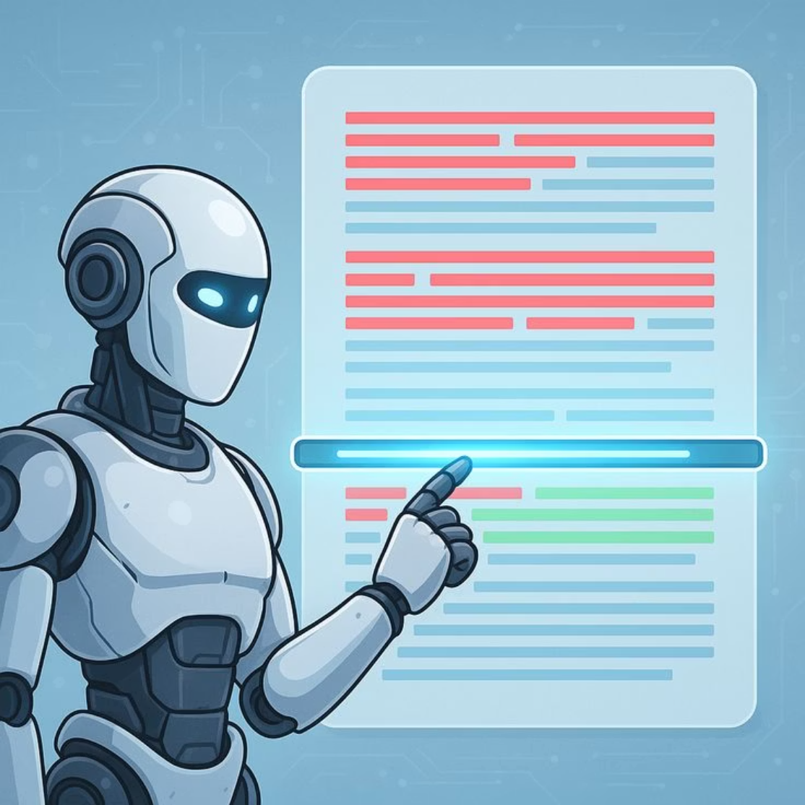
Introduction
Manual analysis of research papers is labor-intensive, requiring significant time to read, understand, and extract key insights from lengthy documents.
Researchers and students face increasing challenges in keeping pace with the volume of literature relevant to their fields of study.
Academic research publications have grown exponentially in recent years, with millions of papers published annually across various domains.
Traditional approaches to paper review often result in missed important details or incomplete understanding of methodologies and contributions.
There exists a critical need for intelligent automated systems that can analyze academic papers and provide structured, comprehensive summaries.

Slide 4
Problem Statement
Length and Complexity
Shallow Summarization
Lack of Academic Focus
Research papers typically span 10-25 pages with dense technical content, complex methodologies, and specialized terminology that require significant time and expertise to comprehend fully
Existing summarization tools provide only surface-level abstracts without capturing the structural organization, key contributions, or domain-specific insights present in academic papers
Current solutions are not optimized for research paper format, failing to identify critical elements such as methodology sections, experimental results, equations, and theoretical frameworks

Slide 5
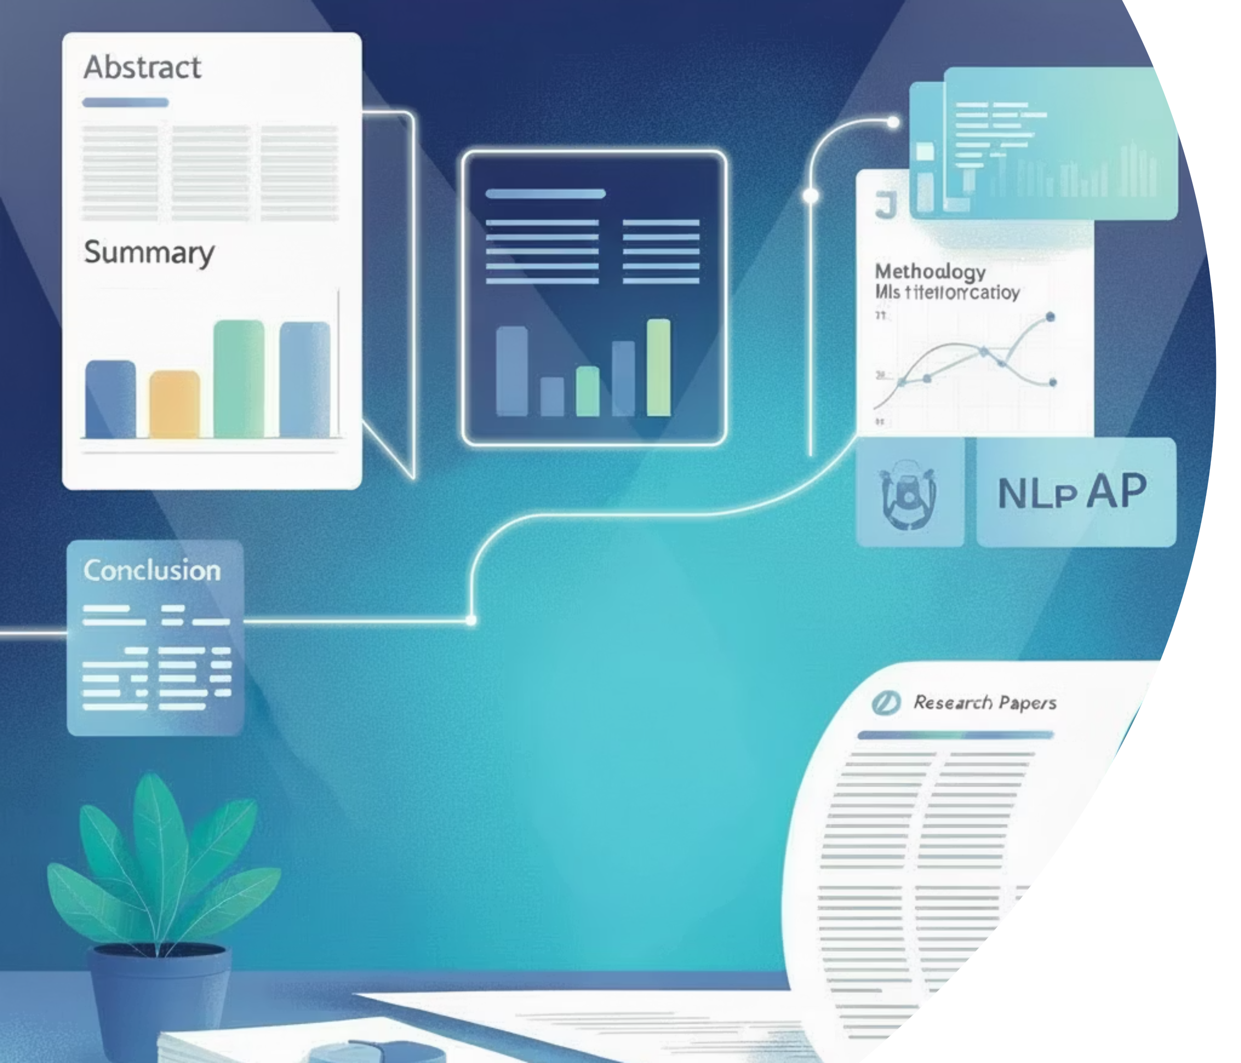
Project Objectives
01
Structured Information Extraction
Automatically extract and organize metadata including title, authors, affiliations, keywords, and publication details from uploaded research papers
02
Section-wise Summarization
Generate concise, accurate summaries for each major section of the paper including introduction, methodology, results, and conclusion
03
Key Insight Highlighting
Identify and extract critical concepts, important definitions, mathematical equations, and novel contributions presented in the research
04
Customizable Output
Provide users with flexible summary formats and detail levels based on their specific requirements and use cases

Slide 6
Main Features of ResearchXtract
Research Paper Upload
Supports PDF documents up to 25 pages for analysis.
Metadata Extraction
Automatically identifies and extracts critical information like title, authors, and publication year.
Section Detection
Intelligently recognizes table of contents and logical sections within papers.
Section-wise Summarization
Generates concise summaries for each major section, such as Introduction, Methodology, and Conclusion.
Key Point Preservation
Ensures important lists and key takeaways are accurately captured and presented.
Keyword & Concept Extraction
Identifies and lists primary keywords and central concepts discussed in the paper.
Definition Highlighting
Automatically highlights and extracts important definitions and key terms.
Mathematical Equation Extraction
Extracts basic mathematical equations for quick reference.
Table-to-Graph Conversion
Converts tabular data into visual graphs where applicable, enhancing data interpretation.
Customizable Summary Export
Allows users to export structured summaries in various formats, including PDF and PPT.

Slide 7
Literature Survey & Research Gap
Existing Approaches
How ResearchXtract Addresses the Gap
General Text Summarizers: Tools like TLDR and SummarizeBot provide basic summarization but lack academic paper structure awareness
Citation-based Systems: Platforms such as Semantic Scholar offer paper overviews but do not perform detailed content analysis
Extractive Methods: Traditional approaches select important sentences without understanding context or maintaining coherence
Generic AI Models: Large language models provide summaries but are not fine-tuned for academic research format and terminology
Recognizes and preserves academic paper structure during analysis
Performs deep content understanding using domain-aware NLP models
Extracts technical elements like equations and definitions accurately
Generates structured, section-wise summaries tailored for academic use

Slide 8
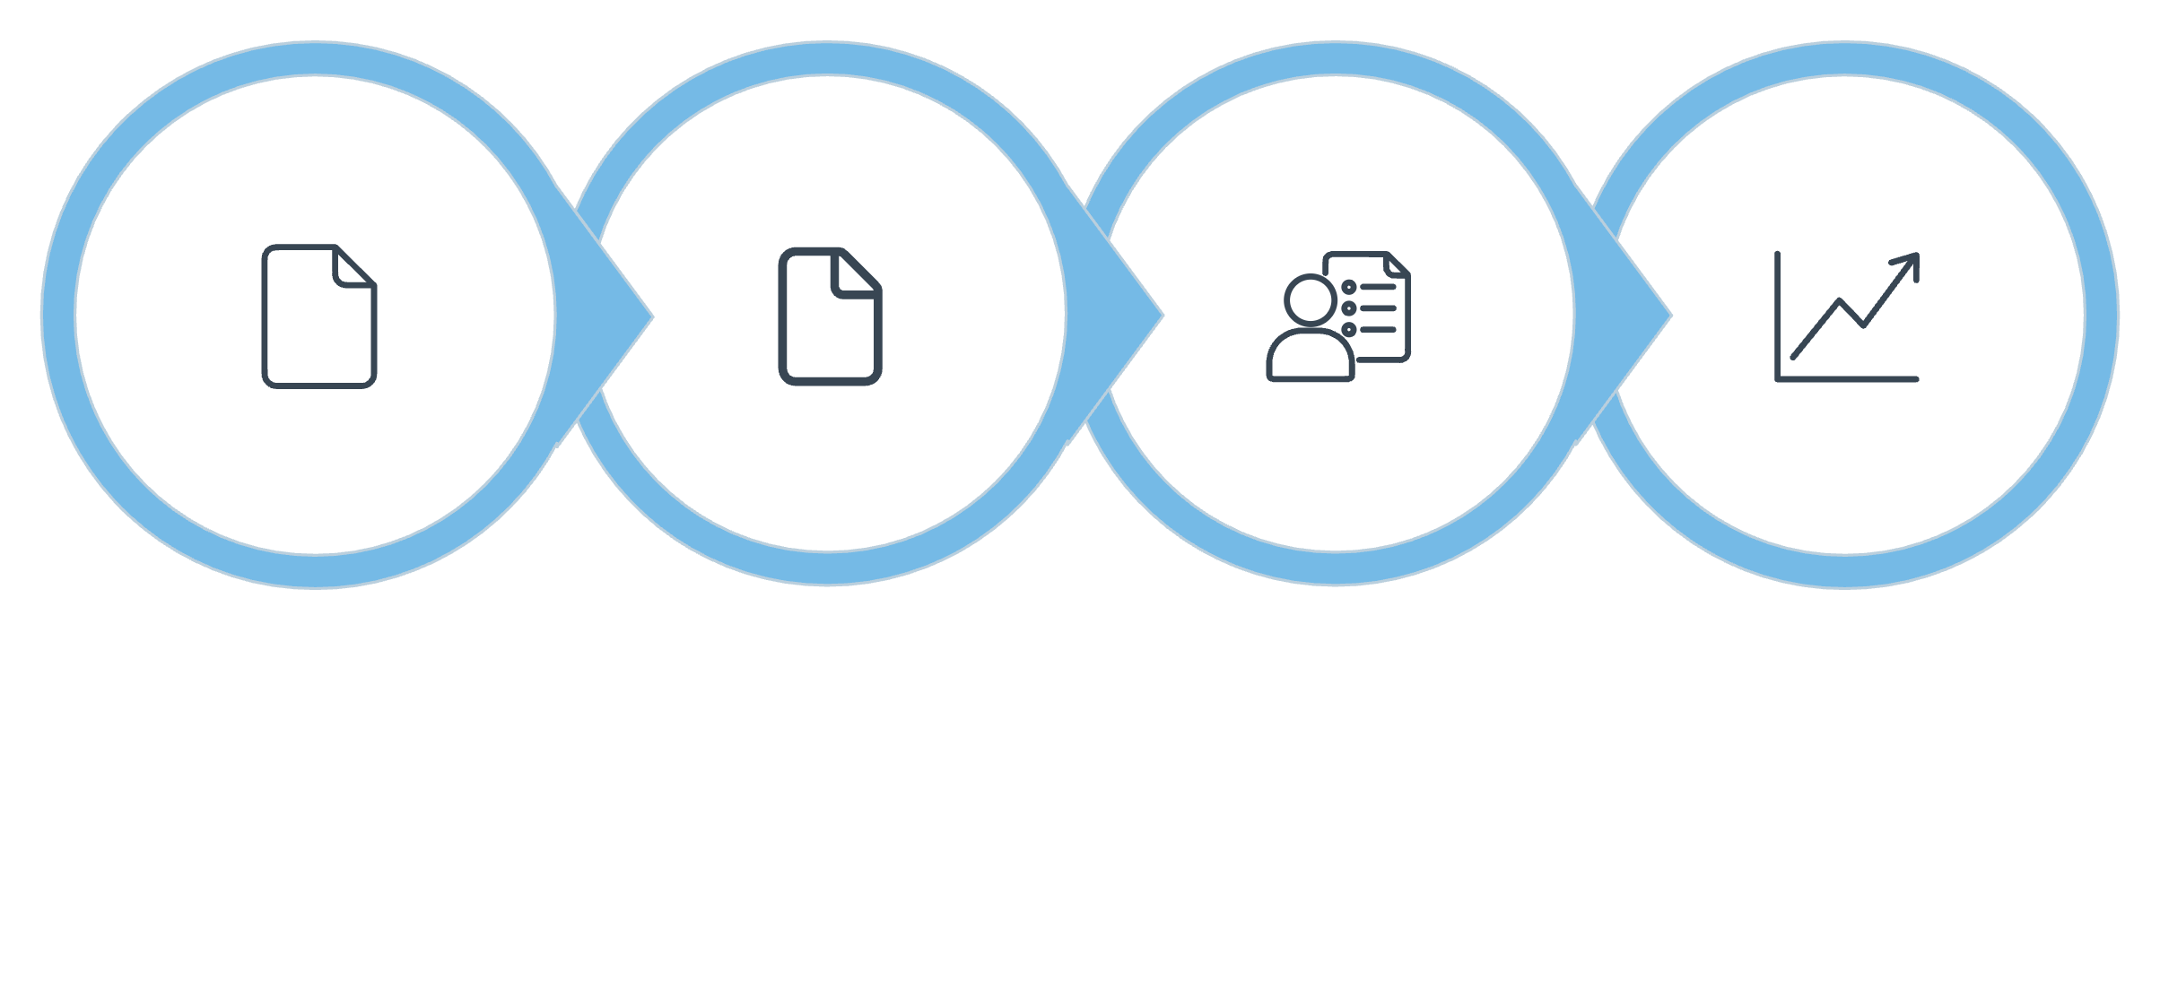




Proposed System Workflow
Extract Metadata
Section Summaries
Structured Output
Upload PDF
The ResearchXtract system follows a streamlined four-stage process. Users begin by uploading a research paper in PDF format. The system then automatically extracts metadata and intelligently detects the paper's structural sections. Advanced AI models perform comprehensive analysis including section-wise summarization and extraction of key insights, definitions, and equations. Finally, the system generates a well-structured output document containing organized summaries, highlighted concepts, and optional visual representations of the paper's contributions.

Slide 9
System Architecture
Frontend Layer
Backend Processing
User-friendly interface for PDF upload
Progress tracking during processing
Interactive result display and navigation
Export options for summary formats
PDF text extraction and parsing
Section boundary detection
Metadata identification and extraction
Document structure analysis
AI Analysis Layer
Output Generation
Transformer-based NLP models
Abstractive summarization engine
Named entity recognition
Equation and formula extraction
Structured summary compilation
Key insight highlighting
Visual representation creation
Formatted document generation

Slide 10




Technologies Used & Results
Python
Sample Results
Core programming language for backend development and integration
Successfully processed research papers across multiple domains including computer science, engineering, and life sciences
Achieved average summarization accuracy of 85-90% as evaluated against human-generated summaries
Reduced paper analysis time from 2-3 hours to under 5 minutes per document
Correctly identified and extracted 95% of mathematical equations and key definitions
Generated well-structured outputs with clear section organization and highlighted insights
NLP & Transformers
BERT, GPT-based models for text understanding and summarization
PDF Processing
PyPDF2, PDFMiner for text extraction and parsing
Visualization
Matplotlib, Plotly for generating insight visualizations

Slide 11
Conclusion
Advantages
Limitations
Future Scope
Provides accurate, academically-focused summaries tailored for research papers
Maintains structural organization and coherence in generated summaries
Saves significant time in literature review and paper analysis
Extracts technical elements like equations and definitions with high precision
Current version limited to papers up to 25 pages in length
Processing time increases with document complexity and length
May require manual verification for highly specialized domain terminology
PDF quality affects text extraction accuracy
Extend support for larger documents including dissertations and technical reports
Implement conversational chatbot interface for interactive paper exploration
Develop advanced recommendation engine for related paper discovery
Add multi-language support for international research papers

